Slide 1



M43581 – Results of FTV-Wei project: Real-time free-viewpoint videoconferencing system
Grupo de Tratamiento de Imágenes, Universidad Politécnica de Madrid
Pablo Carballeira, Daniel Berjón, Sergio Arnaldo, Carlos Carmona, Daniel Corregidor, Carmen Doblado, M. Mar Martín, Julián Cabrera, César Díaz, Francisco Morán, Narciso García
Huawei Technologies Co., Ltd.

Slide 2
CALIBRATION
CAPTURE
TRANSMISSION
SYNTHESIS
MOBILE
SYNCHRONIZATION
End-to-end real-time free-viewpoint videoconferencing system
Low cost
Consumer-grade cameras providing RGB+D (colour + depth) data
Off-the-shelf hardware
Real time ⇒ low delay
Novel view synthesis algorithm and RGB+D processing tools
Coding and transmission based on MPEG technologies

Slide 3
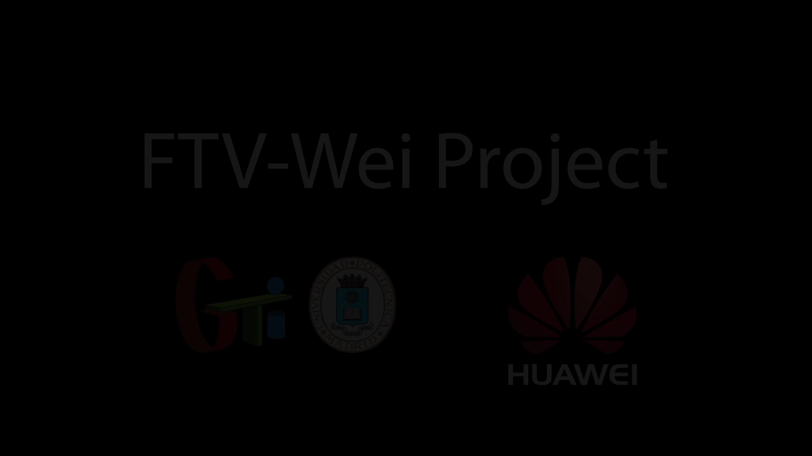

Slide 4
